Slide 1
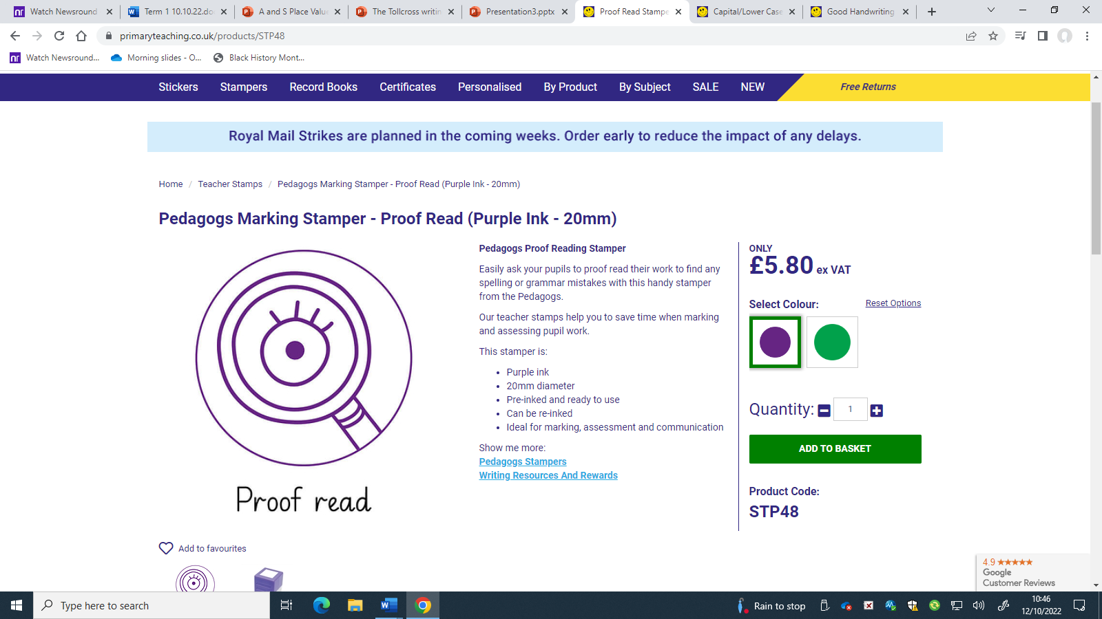
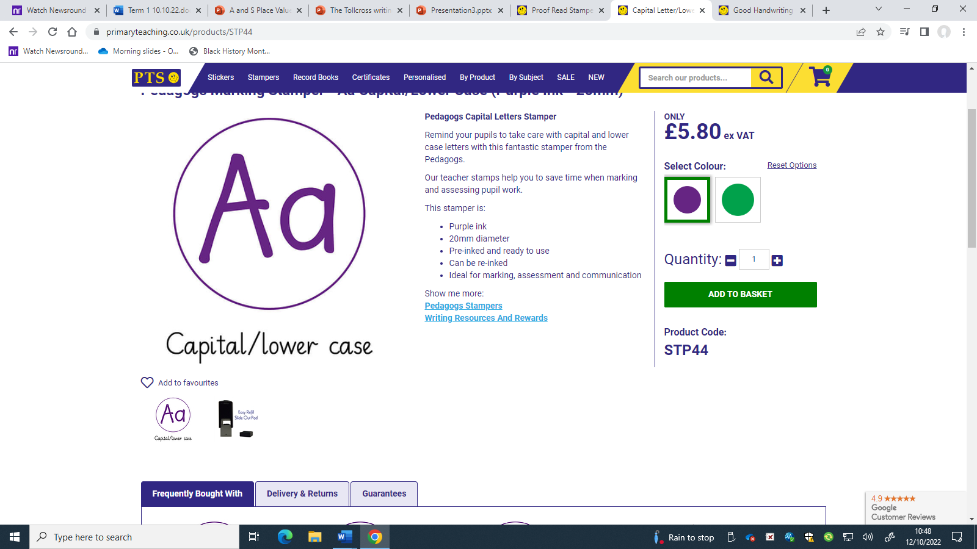
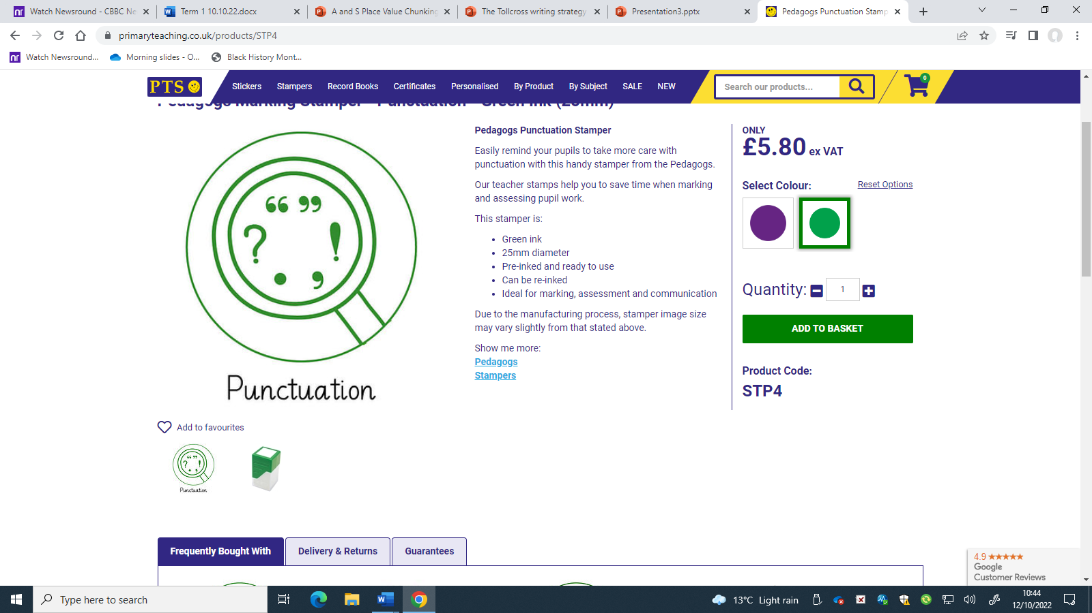
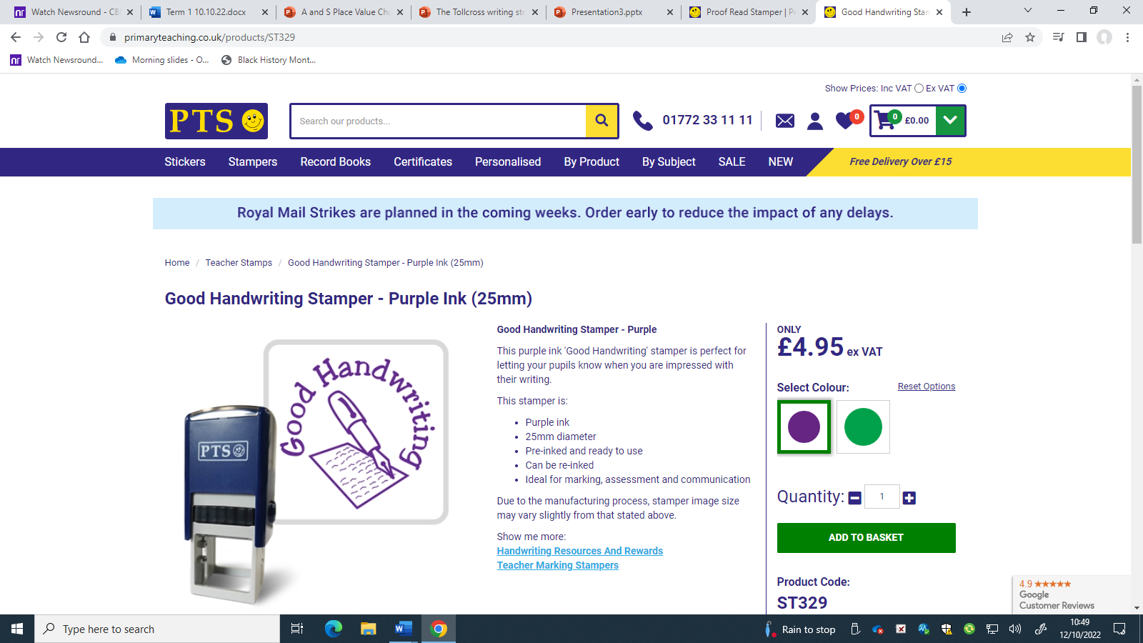
Tollcross Writing
Non-Negotiables
Proof Read- Have I missed out any words? Do my word choices make sense?
Capitalize beginning of sentences and names of proper nouns.
Punctuation at the end of every sentence.!?
, Commas for lists.
"" Speech marks for any speech.
Neatness – Use your best handwriting. Is your writing easy to read? Are there clear paragraphs?

